Slide 1
Trimaran-3 An overcommitment-aware scheduler Demonstration
Asser Tantawi
IBM Research

Slide 2
Demo scenarios
Scenario I: Risk of limits
Burstable pods spike their resource usage (CPU and/or memory) initially, then usage goes down considerably
If pods are scheduled on same node, they run into throttling and/or OOM
Example: Spring Boot applications
Scenario II: Risk of load
Burstable, compute-intensive workload (PARSEC 3.0)
Schedule bursting pod given over-committed nodes
Load-awareness shortens running time by a factor of two

Slide 3
Scenario I
Risk of limits

Slide 4
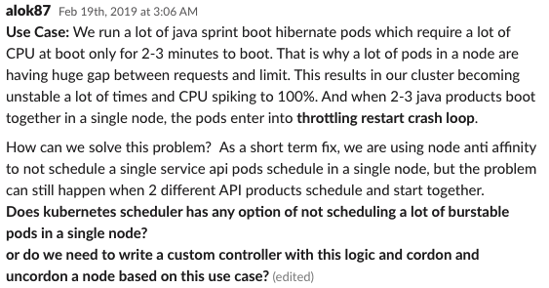
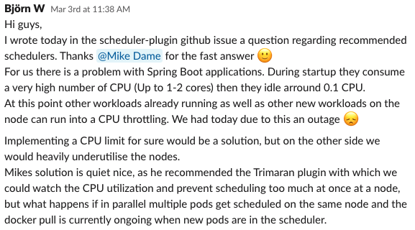
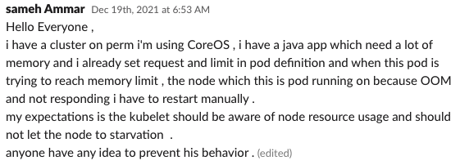
Scenario I

Slide 5
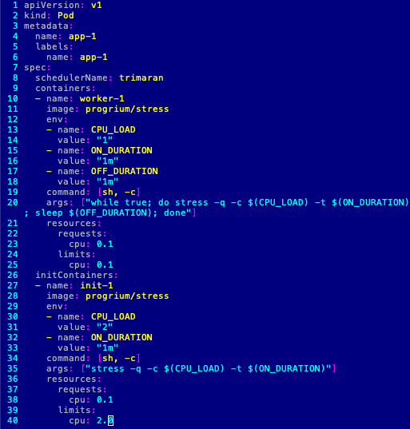
Pod spec
container | request | limit | usage
init | 0.1 | 2.0 | 2.0
main | 0.1 | 0.1 | 0.05
cores
2.0
init
main
0.1
time

Slide 6
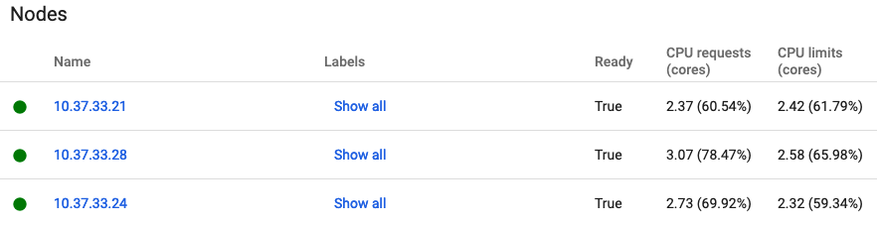
Cluster config
4.0
2.37
0.1
2.0
node-21
app-1
2.73
node-24
app-2
3.07
app-3
node-28
allocated
capacity

Slide 7
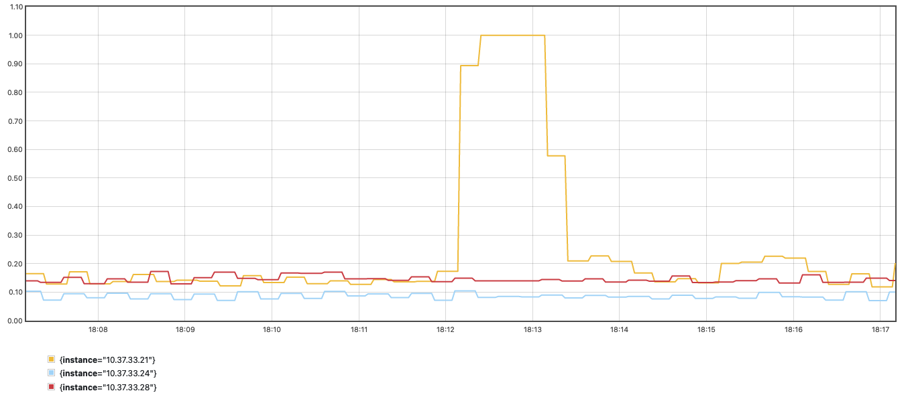
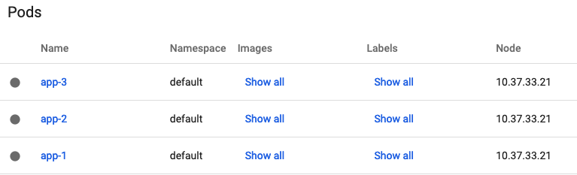
100%
Default
utilization
overcommitment
node-21
app-1
app-2
app-3
node-24
node-28
allocated
capacity

Slide 8
Trimaran-3
place app-1:
place app-2:
place app-3:
very light load

Slide 9
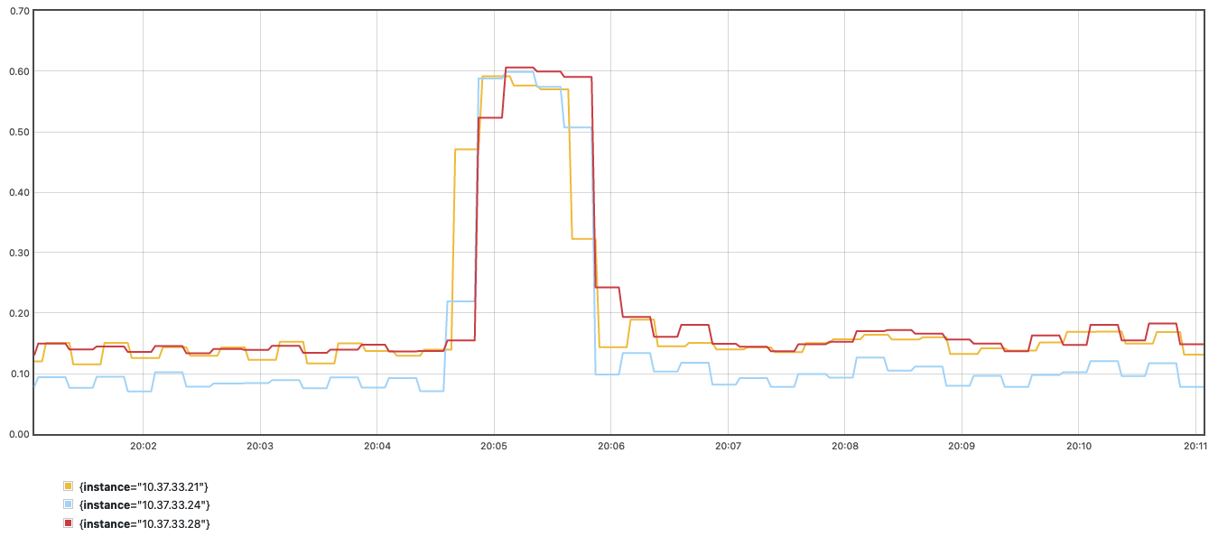
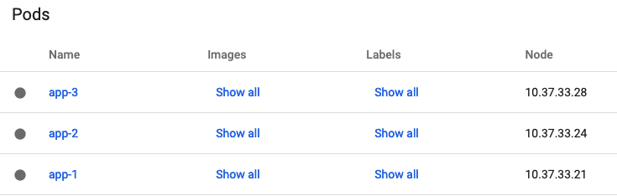
Trimaran-3
60%
utilization
overcommitment
node-21
app-1
node-24
app-2
node-28
app-3
allocated
capacity

Slide 10
Scenario II
Risk of load

Slide 11

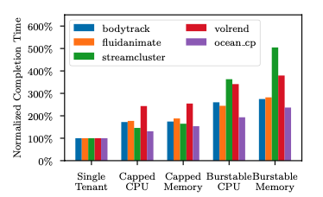
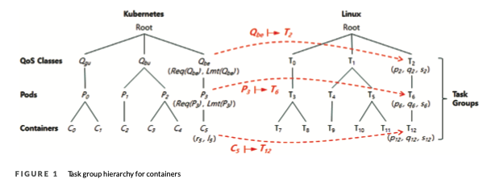
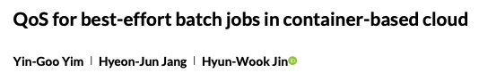
Scenario II

Slide 12

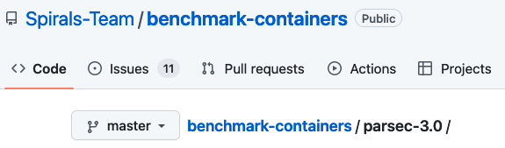
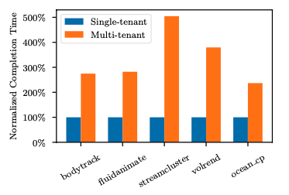
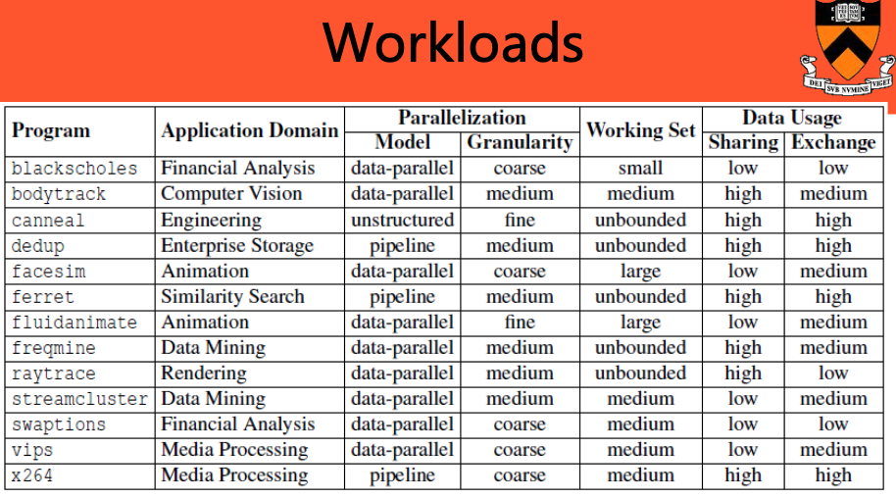

Scenario II

Slide 13
Experiment
4.0
app-pod
0.5
runtime
limits
node-21
4
high
usage
usage
requests
limits
node-24
4
medium
usage
usage
requests
limits
node-28
4
low
usage
requests
usage

Slide 14
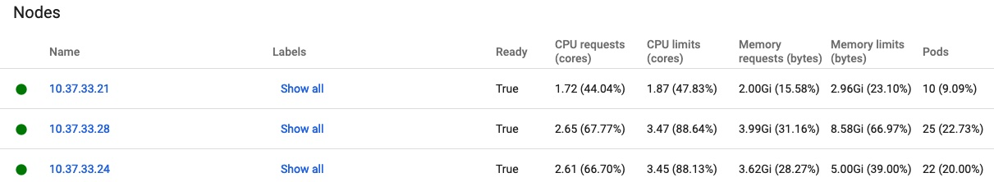
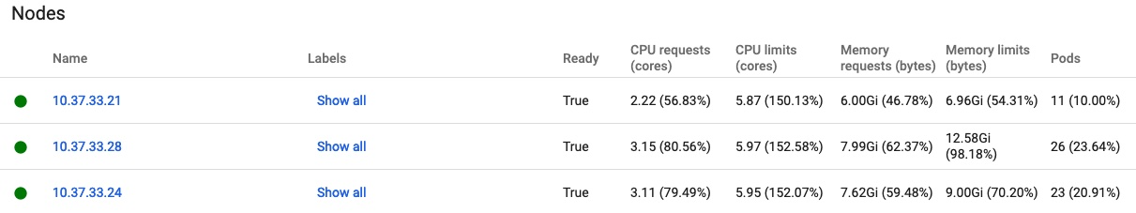
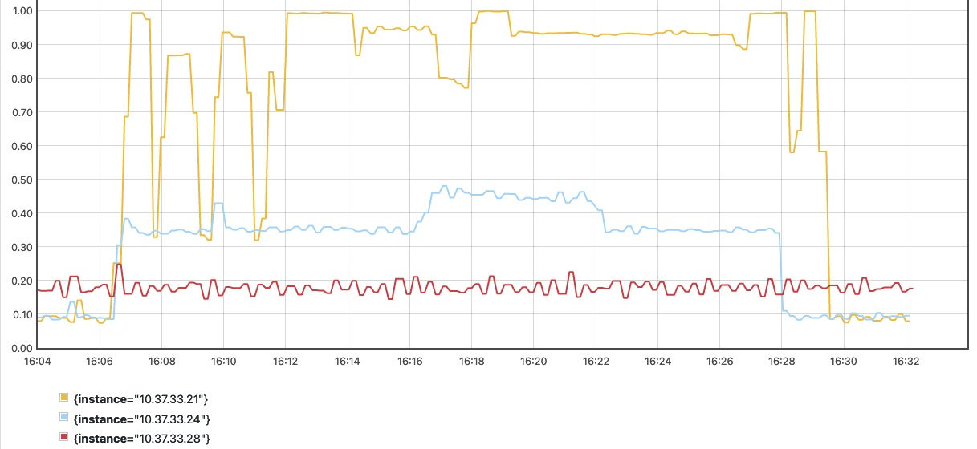
initially
background load

Slide 15
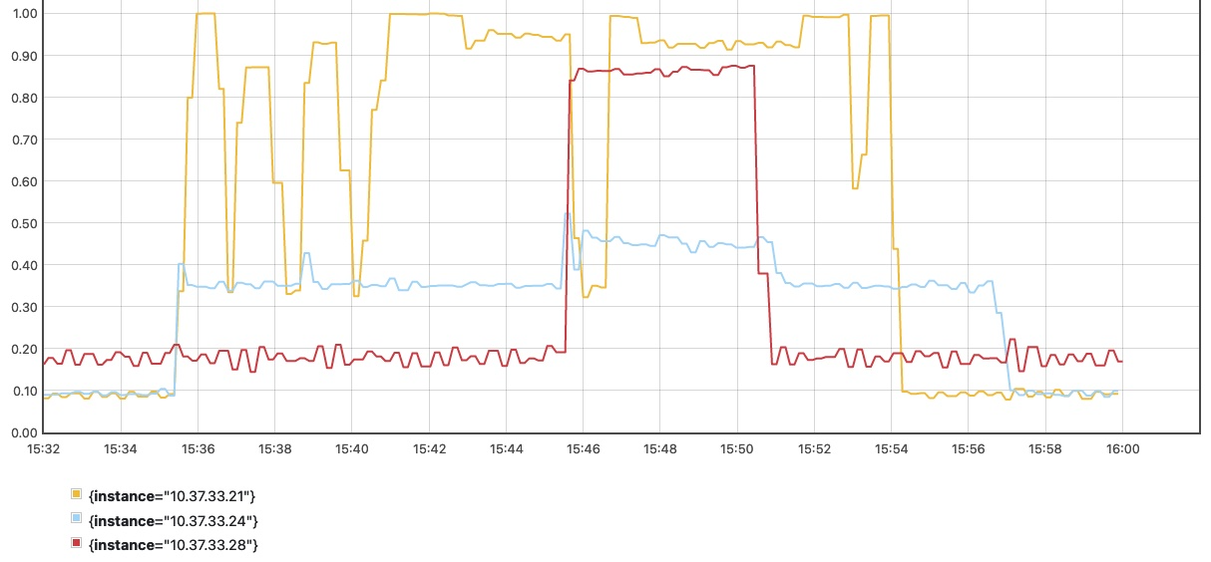
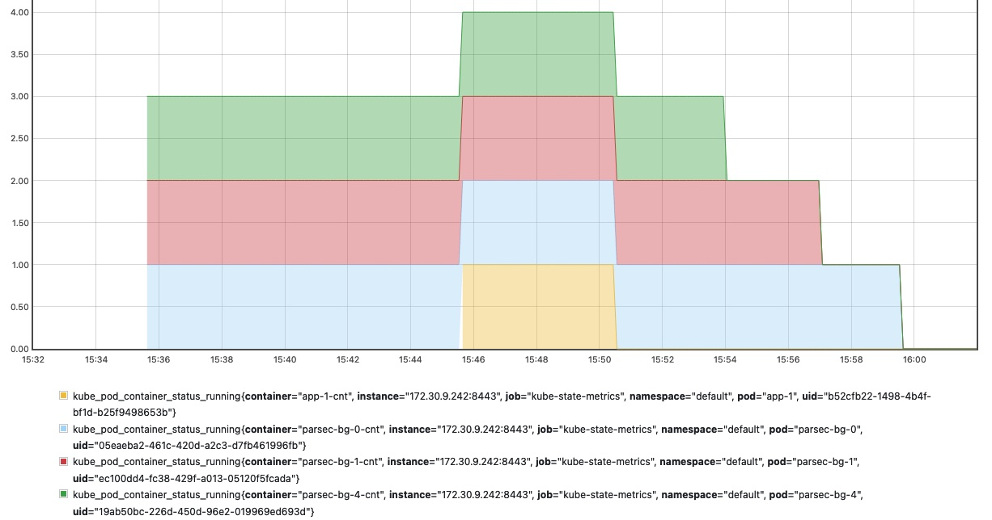
5:05
app-pod -> node-28
trimaran-3

Slide 16
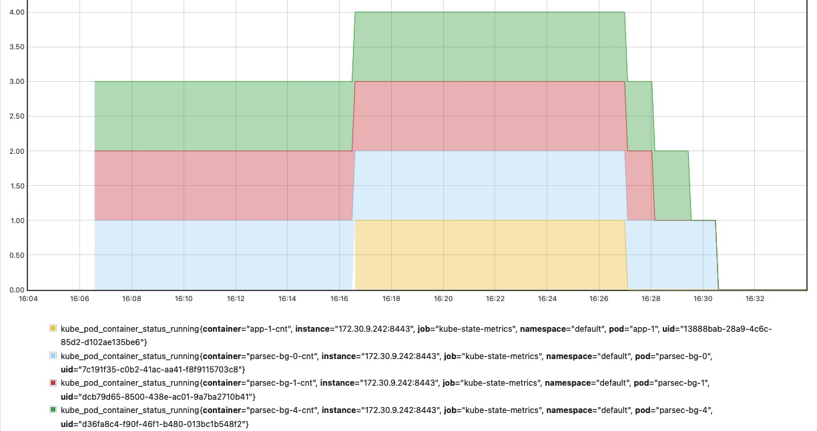
10:13
app-pod -> node-21
default

Slide 17
Trimaran-3

Slide 18
Trimaran-3

Slide 19
Trimaran-3

